Slide 1

Big Data Project Medicare Fraud Detection Using Open Source Data
Xinyu (Max) Liu
xinyulrsm@gmail.com
Project link:
http://nbviewer.jupyter.org/github/maxliu/health_care/blob/master/HealthCare_fraud_detection.ipynb

Slide 2
Project overview
Goal: Build a predictive model for detecting health care fraud
Data source
Part-D and Payment data: cms.gov
NPI exclusion data: hhs.gov
Technology
Hadoop/Yarn/Spark/Hive: Part_D and Payment data are stored in a five-node cluster.
Pig: Pig scripts were written for cleaning data and merging tables.
Python/SciKit-learn: Implemented a data processing pipeline including scaling and modeling. t-test is used to select drugs on training set for feature extraction.
Algorithm and result
Five different models: Logistic regression, Gaussian, Random Forest Classifier, Extra Trees Classifier, Gradient Boosting Classifier
Average AUC: 0.69 (Random Forest)

Slide 3
Fraudulence in health care industry
Data source: en.Wikipedia.org/wiki/Medicare_fraud
Year | People Charged | False Billings (Million)
2010 | 94 | $251
2011 | 91 | $295
2012 | 2 | $1.9
2013 | 89 | $223
2014
2015 | 243 | $712

Slide 4
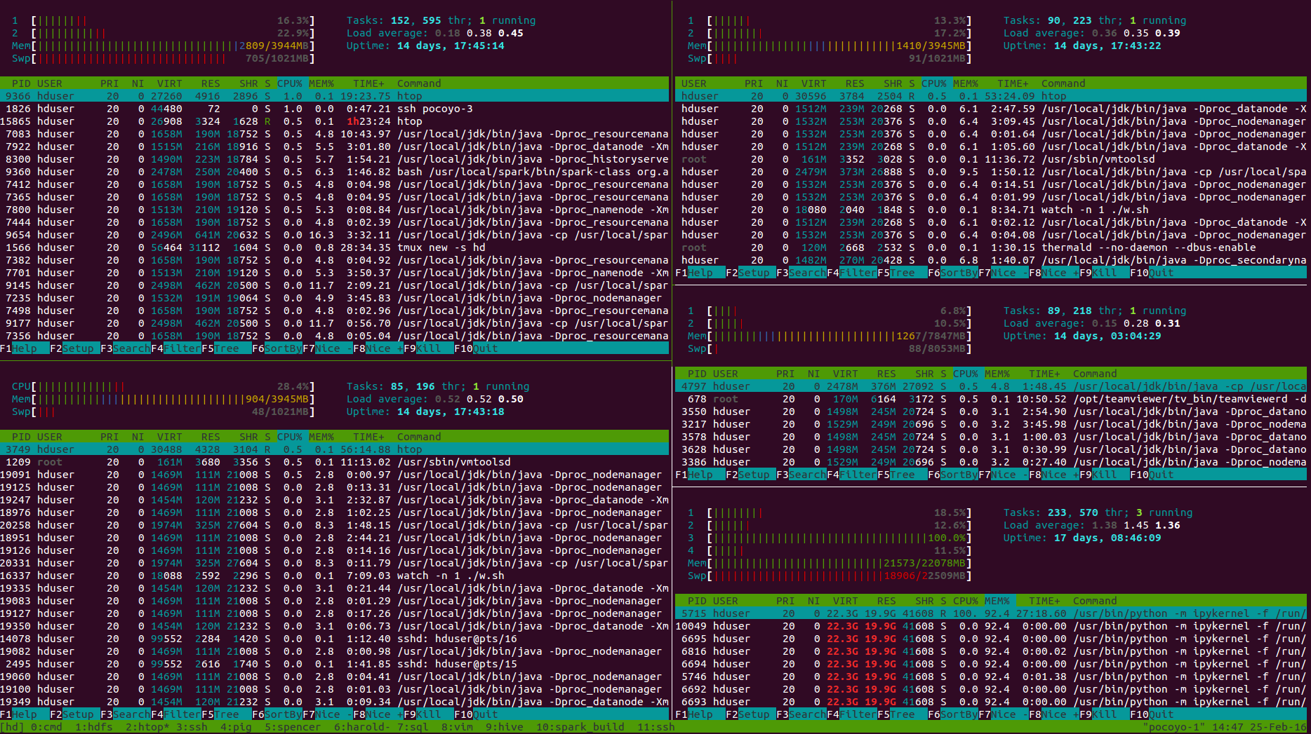
Date storage: 5-node Hadoop/yarn/spark cluster
Node 1
2 Core
4GB Memory
Node 3
2 Core
4GB Memory
Node 4
2 Core
8GB Memory
Node 3
1 Core
4GB Memory
Node 5
4 Core
22GB Memory

Slide 5
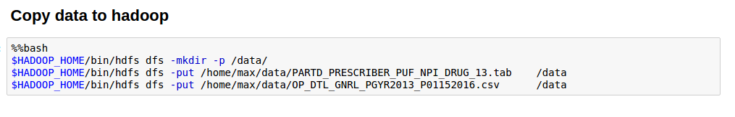
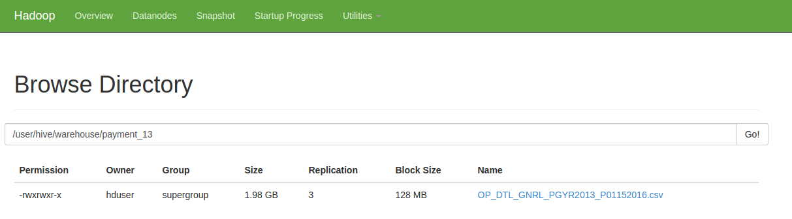
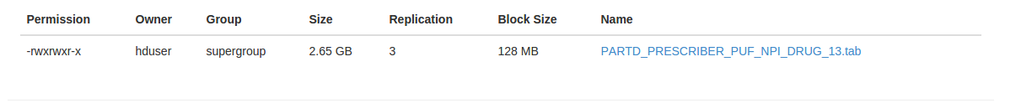
Copy files to Hadoop then move to Hive warehouse

Slide 6
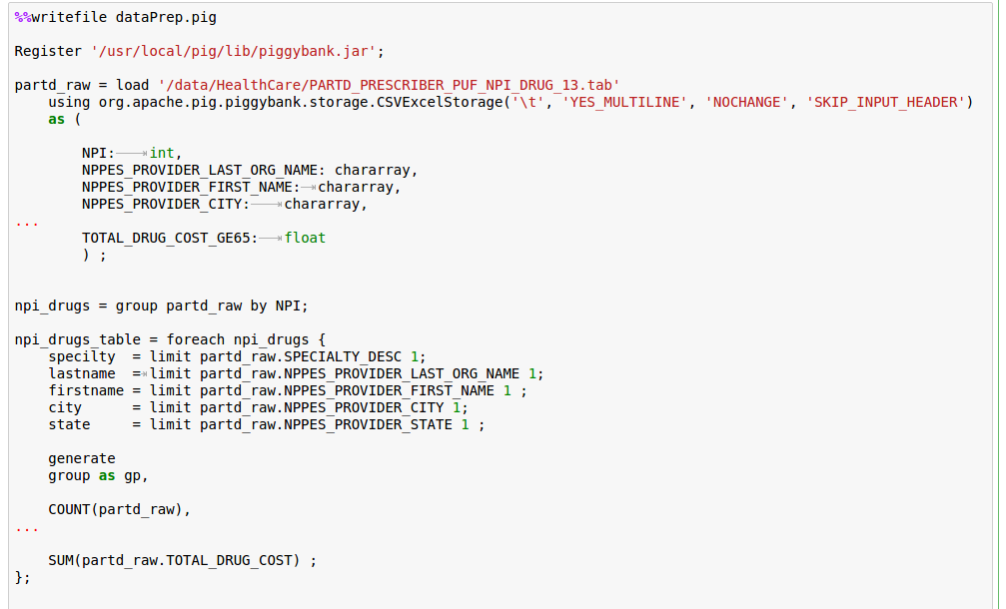
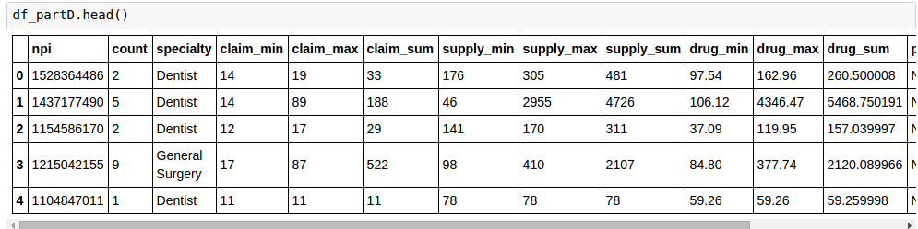
Pig scripts for cleaning data and merging tables

Slide 7
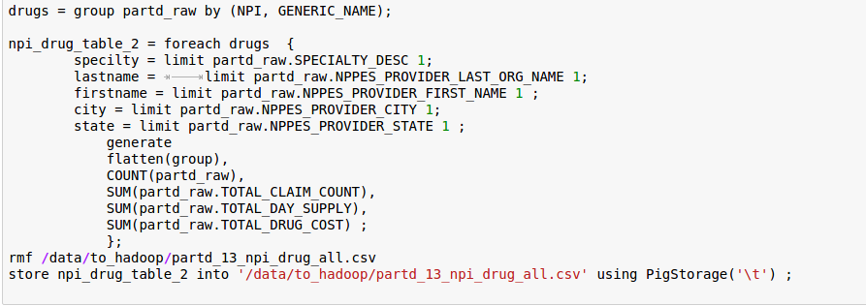
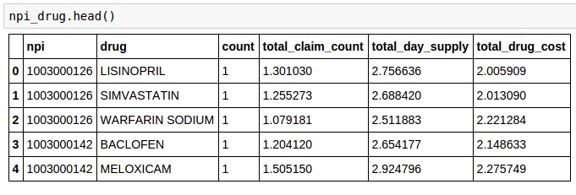
Group part_D data by NPI and drug name for future analysis

Slide 8
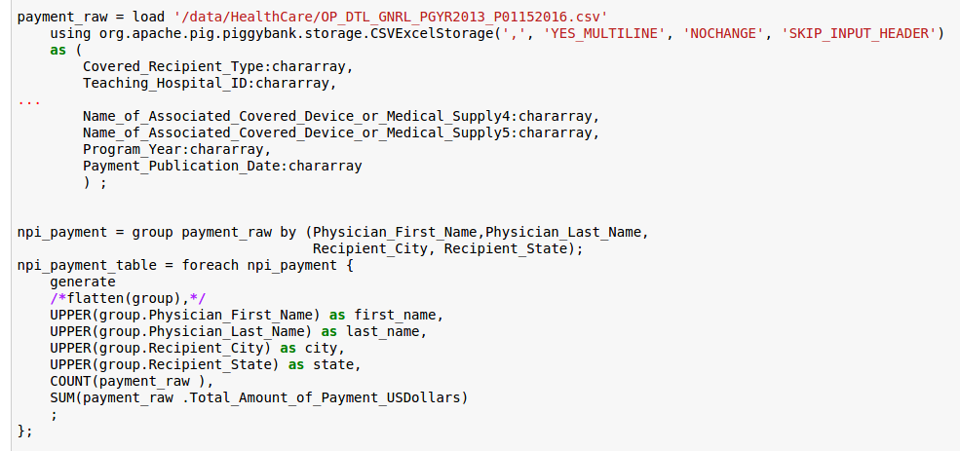
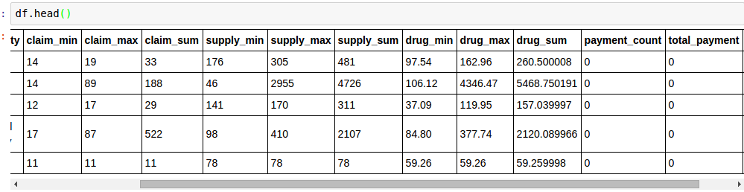
Group Payment data by NPI for future analysis

Slide 9
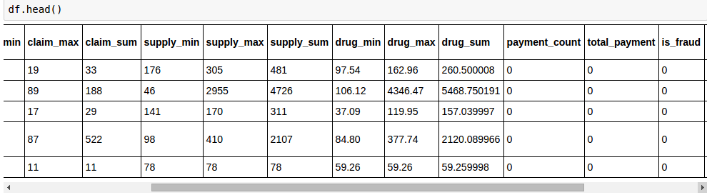
NPI exclusions database used as target
Merged exclusion data to the table as “is_fraud” column

Slide 10
The data is highly unbalanced.
Only 427 positive samples in total 808076 records (0.05%).
Possible solutions
Down sampling
Up sampling
Give higher weight topositive samples for model training ( used in this project)

Slide 11
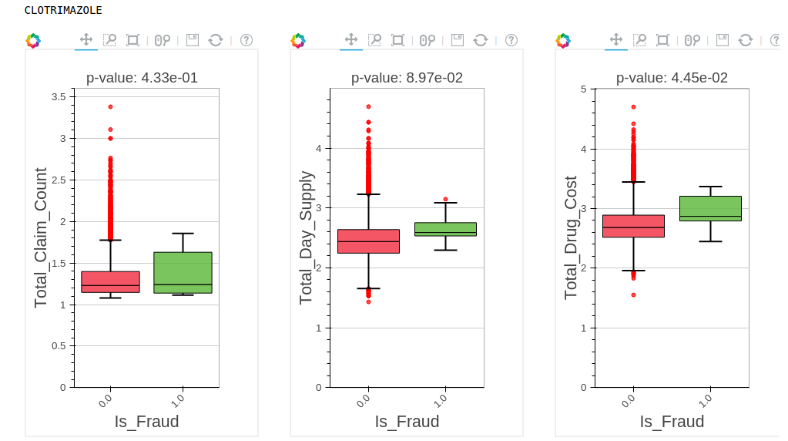
t-test: Select the drug feature only when P <= 0.05
No
No
YES
An example for
“CLOTRIMAZOLE”
Note that this feature selection was only applied on training set to avoid data leakage.

Slide 12
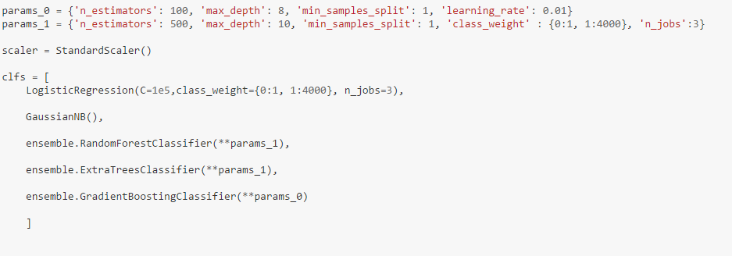
Five different models used:
Logistic regression, Gaussian, Random Forest Classifier, Extra Trees Classifier, Gradient Boosting Classifier

Slide 13
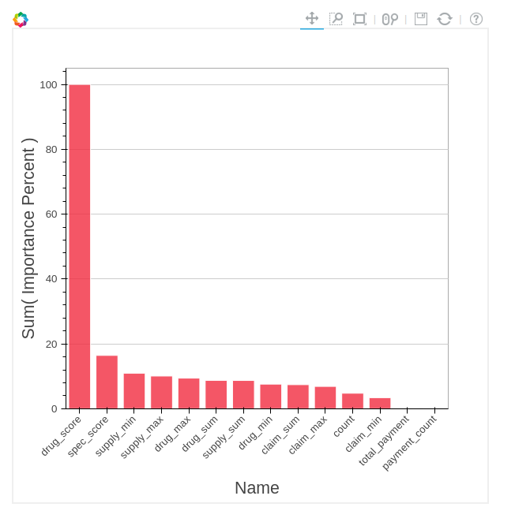
Feature importance analysis (from Random Forest)
Findings
The “drug_score” feature created become the most important feature
The payment turned out to be trivial or negligible.

Slide 14
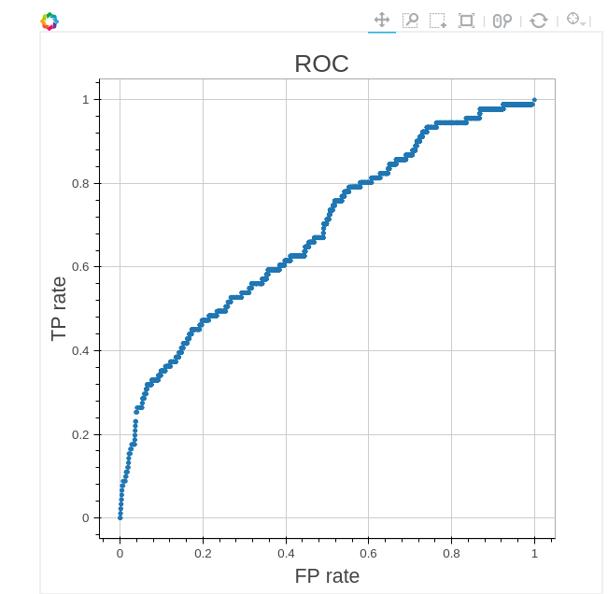
AUC (from Random Forest)
Average AUC ~ 0.685 (> 0.5)
This means the predictive model I built can provide useful information on health care fraud detection.

Slide 15
Future work for improvement
Include more data (e.g., the Part-B dataset)
Add additional feature (e.g., Page rank)
Blend multiple model

Slide 16
References
https://www.versustexas.com/criminal/healthcare-medicare-medicaid-fraud/
PageRank for Anomaly Detection,
By Ofer Mendelevitch and Jiwon Seo
http://www.dataiku.com/blog/2015/08/12/Medicare_Fraud.html
By Pierre Gutierrez @ Dataiku

